Slide 1
Igneous Petrology
Geology 12

Slide 2
Petrology is the study of rocks and their formation. A rock is simply one or more minerals attached in some manner; it is usually a mixture.
According the principles of uniformitarianism, the geologic processes now at work were also active in the past, and the physical features of the earth were formed from these processes over long periods of time. From this, we can surmise that the rocks we see around us were also formed in the past by the same geological processes we see around us today.

Slide 3
There are three broad classes of rock:
Igneous rock – formed when molten magma or lava cools
Sedimentary rock – formed either from eroded sediment (mud, sand, gravel, etc) that is deposited and cemented together into new rock, or forms by precipitating out of solution.
Metamorphic rock – formed when a rock experiences intense heat and pressure, altering the rock’s mineralogy and characteristics.

Slide 5
Igneous Rocks
Melting and Crystallization
The Igneous Family includes a wide range of rocks that can form either inside the planet or on the surface. However, at some point all igneous rocks were in a molten (melted) form. If the liquid rock is underground, it is called magma. If the liquid rock is found at the surface, it is called lava.
In this section of the course we will study the processes of how magma forms and how it cools and crystallizes into different types of rocks. Igneous rocks compose more than 50% of the Earth’s crust.

Slide 6
Origin and Crystallization of Magma
There is a lot of heat in the interior of the Earth. Some of this heat comes from the formation of the Earth. Some of it is also from radioactive decay of certain elements, such as Uranium and Thorium. The interior of the Earth is up to several thousand degrees Celsius. At these temperatures, most elements and compounds are above their melting point. The immense pressure in this setting, however, keeps the mantle from being a ‘true’ liquid.

Slide 7
Origin and Crystallization of Magma
When weaknesses (cracks, faults, etc.) in the crust allow this material to get closer to the surface, the pressure becomes less extreme, and the material can change into a liquid form. This material is technically called melt, but is more commonly called magma.

Slide 8
Origin and Crystallization of Magma

Slide 9
Origin and Crystallization of Magma
As the material migrates upwards heat energy is lost to the surrounding rock (country rock). As the temperature drops, in atoms will slow down and begin to interact with each other. They can react and form new compounds. These compounds will be nuclei for new mineral crystals to grow.

Slide 10
Origin and Crystallization of Magma
Not all minerals form at the same time since each one has a unique melting/freezing point. There is an order to the process, called the Bowen’s Reaction Series. The basic principle is that certain minerals crystallize out of the melt first, and then react with the remaining melt, forming new and/or altered minerals, until all the magma is crystallized.

Slide 11
Plutonic vs. Volcanic Rocks
The major division for igneous rocks is based on rate of cooling. Plutonic rocks or intrusive rocks cool slowly within the earth. They produce relatively large and interlocking crystals.
Volcanic rocks or extrusive rocks form when lava cools on the Earth’s surface. They cool rapidly and the crystals that form are relatively small.

Slide 12
Plutonic vs. Volcanic Rocks
Once it has been determined whether the rock is plutonic or volcanic, the name given is on the basis of colour and mineralogy.
Magmas that form dark coloured minerals form dark coloured rocks.
Magmas that form light coloured minerals form light coloured rocks.

Slide 13
Plutonic vs. Volcanic Rocks
Plutonic and volcanic rocks have different names. They are classified by their percentage of ferromagnesian minerals. Dark minerals typically contain more iron and magnesium.

Slide 14
Terminology
Mafic:
Magma that is rich in iron-magnesium (less Si)
Forms minerals that are (generally) darker in color
Magma/Lava has low viscosity (low silica = ‘runnier’)
Resulting rock is poor in quartz, rich in ferromagnesian minerals

Slide 15
Terminology
Felsic:
Magma that is silica-rich (less Fe and Mg)
Forms minerals that are (generally) lighter in color
Magma/Lava has high viscosity (silica = ‘stickier’)
Resulting rock is rich in quartz and feldspar

Slide 16
Textural Terminology
Grain Size:
Size of individual mineral crystals (fine vs. coarse)
→depends on cooling history/conditions
Aphanitic:
When mineral crystals are very small (‘fine’)
→magma cooled quickly = little time to form
Phaneritic:
When mineral crystals are large (‘coarse’)
→magma cooled slowly = lots of time to form/grow

Slide 17
Textural Terminology
Glassy:
When no crystals are present
→magma cooled very fast = no time for growth
Vesicular:
When ‘bubbles’ are present in a rock
→gas bubbles were trapped during cooling

Slide 18
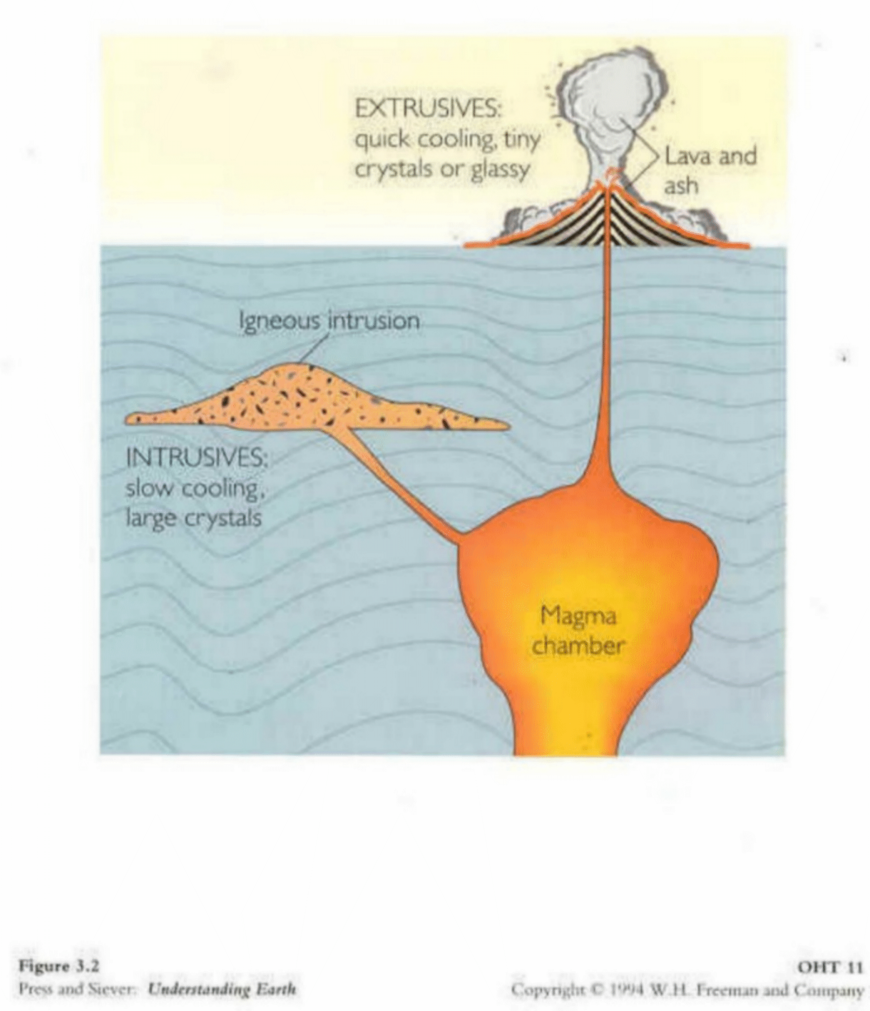

Slide 19
Classification
Igneous rocks are generally classified by the chemistry and where they form. These manifests through the mineral composition (what’s in it) and crystal size (where it formed).

Slide 20
Chemical Classification
a sliding scale, using the terms described earlier:
Felsic | → | Intermediate | → | Mafic
High Silica content |  | → |  | Low Silica content
Light colored minerals |  | → |  | Dark colored minerals

Slide 21
Physical Classification
grain (crystal) size tells you location of formation:
Plutonic/Intrusive Volcanic/Extrusive
Large crystal size Small crystal size
Formed in the crust Formed at/near surface

Slide 22
Names
Once you have described a rock by its color (~mineralogy) and crystal size, you can use a chart to determine specific rock name.
Colour of Rock | Volcanic Name (fine-grained) | Plutonic Name (course-grained)
Very Dark (ultramafic) |  | Peridotite
Dark (mafic) | Basalt | Gabbro
Medium (intermediate) | Andesite | Diorite
Light (felsic or silicic) | Rhyolite | Granite

Slide 23
15

Slide 24
Names
Plutonic Rock | Overall Colour | Major Minerals Present
Granite | Light, few dark minerals | Noticeable glassy quartz and light orthoclase (K) or albite (Na) plagioclase feldspars (felsic/ acidic). The few dark minerals are biotite or hornblende.
Pegmatite | Light, few dark minerals | An extremely coarse grained light coloured phaneritic rock, similar composition to granite.
Syenite | Light, few dark minerals | Pink, grey and white orthoclase (K) and plagioclase (Na) feldspars (felsic), and no quartz The few dark minerals are biotite or hornblende.

Slide 25
Names
Plutonic Rock | Overall Colour | Major Minerals Present
Quartz Diorite (Tonalite) | Medium, similar proportions of light and dark minerals | Light minerals, mostly albite (Na) feldspars with some quartz and plagioclase feldspar. Dark minerals are hornblende or biotite.
Diorite | Medium to dark, more dark minerals | Feldspars, mostly grey Ca plagioclase. Dark minerals commonly hornblende, some pyroxene.
Gabbro | Dark grey to black | Mostly dark magnesium and iron minerals, no quartz and some calcium feldspar (mafic).
Peridotite | Dark Black | Mostly pyroxene and olivine with a little calcium plagioclase (ultramafic).

Slide 26
Names
Volcanic Rock | Overall Colour | SiO₂ | Viscosity
Rhyolite | Light – pale grey, cream | High | High
Dacite | Greenish grey, grey | Medium | Med-High
Andesite | Grey, light brown | Medium | Med-Low
Basalt | Dark – brown, black | Low | Low

Slide 28
Other Igneous Rocks
Porphyry is a rock which has both large and small crystals. It has a two stage cooling history: magma started out cooling slowly so large crystals form/grow (called phenocrysts). A sudden change (like an eruption) brings magma closer to or on surface, and the remaining melt cools quickly (into a fine-grained ‘cement’ called groundmass),
Obsidian is very glassy. Although it is usually black in colour, it is usually rhyolitic in composition. Forms from lava with very high water content.

Slide 29
Other Igneous Rocks
Pumice is a low density, frothy, porous, light-coloured rock formed from gassy rhyolite.
Scoria forms from basalt with a high gas content, creating a very open network of vesicles. It is denser and darker than pumice.
Pyroclastics are broken up angular fragments of igneous volcanic rock. Tuff is a rock formed from volcanic ash less than 4 mm wide. Volcanic breccia is formed from fragments greater than 4 mm wide.

Slide 30
Bowen’s Reaction Series
Norman Bowen found that minerals melt (and solidify) in a particular sequence.
There are three parts to BRS: The discontinuous series (including olivine, pyroxene, amphibole, and biotite); the continuous plagioclase feldspar series; and the residual phases (including quartz, muscovite, and potassium feldspar).

Slide 31
Bowen’s Reaction Series

Slide 32
Continuous Series
right side of Bowen’s Reaction Series
Ca⁺² and Na⁺ can switch places in the mineral plagioclase feldspar.
At high temperatures plagioclase only has Ca, while at low temperatures, plagioclase only has Na.
In between, these ions mix in a continues series from 100% Ca and 0% Na at the high end of the series to 50% Ca and 50% Na at the middle temperatures to 0%Ca and 100% Na at the lowest temperatures.
During this continuous reaction, the early formed plagioclase crystals react continuously with the melt to become enriched in silica and sodium and depleted in calcium.

Slide 33
Continuous Series

Slide 34
Discontinuous Series
On the left side of the reaction series are a group of mafic (or iron-magnesium-rich) minerals - olivine, pyroxene, amphibole and biotite
In igneous magmas, if there is enough silica in the melt, each mineral will change to the next mineral lower in the series as the temperature drops.
For example, olivine is the first mineral to form. When the temperature is low enough, all of the olivine will react with the melt to form pyroxene.

Slide 35
Discontinuous Series
As the temperature drops, all the pyroxene will react with the melt to form amphibole; if it continues to drop, all the amphibole will react with the melt to form biotite.
If these minerals react to form other minerals, then how do we find these mafic minerals at the Earth’s surface?
All of these reactions rely on the melt containing enough silica. If there is not enough silica, the reactions will not occur. Minerals further down the series will only form if there is sufficient silica in the melt. Silica is the limiting reagent.

Slide 36
Discontinuous Series

Slide 37
Residual Phases
At the bottom of BRS are the felsic minerals of quartz, muscovite, and potassium feldspar.
These minerals have abundant aluminum and potassium, and higher amounts of silica than the mafic minerals earlier in the series. In fact, quartz is 100% silica.

Slide 38
Residual Phases

Slide 39
Not every magma goes through all steps in Bowen’s series
Silica is needed for the reaction to keep going. If you are crystallizing olivine and there is not enough silica to form pyroxene, then the reaction will not occur and olivine will remain.
A mafic magma (rich in iron and magnesium) will completely crystallize before it reaches the lower temperature stages of the discontinuous reaction.
A silicic magma is rich in silica and poor in magnesium and iron. So, olivine and pyroxene will be reabsorbed and will be absent from the resulting rock.
If you are crystallizing a mineral and the temperature drops rapidly, then the BRS will stop at that point, and further reactions will not occur.

