Slide 1
Plate Tectonics

Slide 2
6.1 Continental Connections
In the 19th century, scientists noticed jigsaw-like fit of South America and the west coast of Africa
same kinds of fossils were found on opposite sides of the Atlantic Ocean
Matching fossil seed ferns (Glossopteris) and reptile remains (mesosaurus) were found in coal beds in both South Africa and Brazil.

Slide 3
Other rock formations that seemed to match very closely if the continents had once been fitted together.
Fit also improved when the edge of the continental shelf was used to join the two landmasses

Slide 4
The Appalachian mountain ranges in the eastern United States were found to have the same geological structure as the mountains of northern Scotland and Scandinavia.

Slide 5
More specimens of Glosseropteris were found in Australia, India, and Antarctica suggesting that they had all been joined to South Africa and South America at some time

Slide 6
Theory of Continental Drift
In the early 1890s, a young German scientist, Alfred Wegener proposed that all the continents had once been joined to create the supercontinent called Pangaea.
The northern section was known as Laurasia and the southern section as Gondwanaland.
His hypothesis is referred to as the Theory of Continental Drift

Slide 8
Evidence of an ancient ice age throughout the southern continents further supported the joining of the continents.
This paleoglaciation evidence showed that the South Pole at that time was in southern Africa.

Slide 9
Even though Wegener supplied a lot of supporting evidence, his hypothesis was not well received
In order to be accepted, an explanation for HOW the continents separated and moved was necessary.

Slide 10
6.2 Magnetic Reversals and Moving Continents
In the 1950s, scientists discovered a large ridge of undersea mountains running approximately North-South through the middle of the Atlantic Ocean.
Scientists noticed that the ridge was also the site of many undersea volcanoes and a lot of earthquake activity

Slide 11
Evidence from remote submersibles showed that the mountains:
contain a rift valley down the approximate centre.
are composed of pillow lavas spewed from multiple vents along the rift.

Slide 12
When tiny particles of iron minerals solidify within cooling lava, they become locked into position, lining up with the Earth’s magnetic poles.
The Earth’s magnetic field is therefore recorded within igneous rocks.

Slide 13
Igneous rocks of different ages show that the earth’s polarity has reversed many times in its history.
While a compass placed on the Earth’s surface today would point towards the North Magnetic Pole, in past reversals the compass needle would have pointed to the South Pole.

Slide 14
In the mid-1950s, scientists discovered that the record of the Earth's magnetic field could be observed in bands of igneous rocks on the ocean floor.
The pattern of magnetic reversals was found to be remarkably symmetrical on either side of the mid ocean ridge.

Slide 15
This phenomenon was soon reported from the Mid Atlantic Ridge south of Iceland and then from many other ridge sites around the world.
This turned out to be a major key in determining that the continents are moving apart.

Slide 16
These patterns of magnetic reversals were found in the basalt rocks on either side of the Mid-Atlantic ridge
New lava ejected through the oceanic crust at the mid-ocean ridges takes on the magnetic direction of the current polarity, so that a regular pattern of alternating magnetism belts appears.

Slide 17
The youngest rocks were found closest to the ridge, while the oldest were closest to the continents.

Slide 18
On a modern map of the world, it can be seen that every landmass that made up Pangea is now separated by an active ridge.
Since the sea floor on either side of the Mid-Atlantic Ridge is being pushed apart, we now have a mechanism for the separation of South America and Africa.

Slide 19
6.3 Shrinking Oceans
New crust is being created at the ridges, pushing the continents apart… but the Earth is not getting any bigger.
Therefore, there must be other places where the crust is being absorbed back into the mantle.

Slide 20
Just off the west coast of Central and South America there is a deep ocean trench.
Similar trenches have been found adjacent to a number of island arcs in the Western Pacific.

Slide 21
The approximate location of the ocean ridge system (purple lines) and the major ocean trenches (pink lines):

Slide 22
The trenches turn out to be the sites of crustal absorption, known as subduction zones.
At these zones, thinner, denser oceanic crust slides under the continental crust to create a deep trench.

Slide 23
The moving crust creates deep level earthquakes at the descending plate boundary.
The friction between the plates, combined with the effect of water dragged down in wet ocean sediments, generates enough thermal energy to produce magma reservoirs and subsequent volcanic activity

Slide 24
Off the coast of Vancouver Island B. C., Washington and Oregon, the ocean floor is being pushed under the west coast of the North American continental landmass.
This forms the Cascadia Subduction Zone.

Slide 25
Other trenches are found adjacent to belts of volcanic islands such as Japan, Indonesia and the Philippines.
At these locations, known as Island Arcs, two oceanic plates are converging, with one plate subducting underneath the other (usually the older, more dense plate).
As with ocean-continent convergence, volcanoes result from the melting of the subducting plate.

Slide 26
6.4 Moving Plates
Geologists divide the earth into layers, either by composition, or by physical properties.
Compositionally, the crust is separated from the mantle by the percentage of silica in the rocks within each layer.

Slide 27
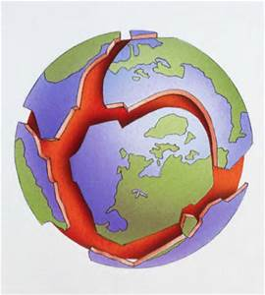
When studying the earth’s plates, it makes more sense to divide the earth’s surface by physical, rather than chemical properties.

Slide 28
The uppermost layer of the earth is composed of rigid plates called the lithosphere. It incorporates the crust as well as the upper part of the mantle.
The lithosphere floats on top of the more plastic part of the upper mantle, known as the asthenosphere.

Slide 29
Today, it is believed that plate movement is due to convection cells in the mantle, driven by thermal energy in the upper mantle.
The convection currents force magma to the surface at ocean ridges, and drive the crustal plates apart at a Diverging Boundary.
At the other end of the cell, the plates are driven together at a Converging Boundary.

Slide 30
Where the hotter mantle is rising to the surface at an ocean ridge or continental rift valley, the plates are being pulled apart.
Further away, the cooler crust sinks back into the mantle, creating subduction zones.
The ridges that result from diverging plates and the trenches that form from colliding and subducting plates form the most common boundaries between the different plates.

Slide 31
There are, however, two other types of activity that can occur at plate boundaries.
At the boundaries between India and Asia, the plates collide, but the collision is between two thick, low-density continental plates.
Instead of subducting, the collision forces the land to buckle and rise, creating the Himalayan Mountain Range.
Likewise, the collision of Africa with Europe produces the Alps and the Caucasus mountains.

Slide 32
In other places, the plates slide past each other as a transform fault.
The San Andrea fault system passes through Southern California and is the location of many earthquakes.

Slide 33
6.5 Plate Tectonics
Geologists now recognize that this wholesale movement of continents has been going on since they were formed and is still happening today.
Research shows that an earlier supercontinent called Rodinia existed, coming together about 1100 Ma ago and breaking apart about 750 Ma ago.
Pangea formed about 260 Ma ago from the Rodinia fragments.

Slide 34
This whole process is now referred to as the Theory of Plate Tectonics.
The theory did not gain widespread acceptance until the 1970's, by which time the evidence was overwhelming.

Slide 35
The Plate Tectonic Theory:
Like any good theory, builds on the supporting evidence and explains many observations of present day geological events.
It can also predict the future positions of the continents in the near geological future.

Slide 36
It is now easy to understand why large coal deposits are found in Antarctica - it was at one time far from its present position in a much warmer and more humid location.

Slide 37
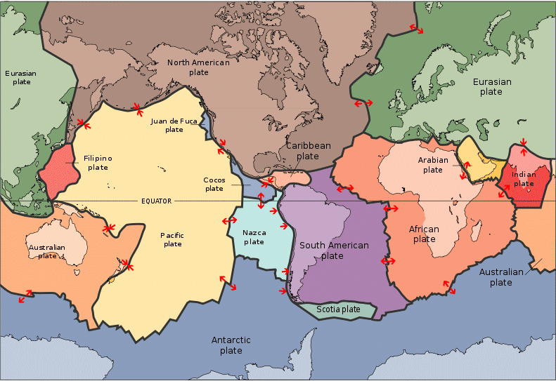
Plate Boundaries
Plate boundaries are marked by earthquakes, volcanoes, mountain ranges and ocean ridges.
There are three main types of plate boundaries:
1) Divergent Boundaries
2) Convergent Boundaries
3) Transform Boundaries

Slide 38
Divergent Boundaries
Where plates are spreading apart, basaltic lava erupts and spreads out to form new oceanic crust.

Slide 39
When divergent boundaries occur under continental plates, they form a rift valley.
As the valley grows, new ocean basins may form.

Slide 40
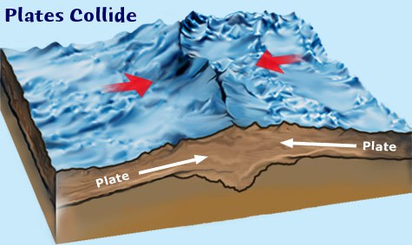
Convergent Boundaries - Continent/Continent
When continental plates collide, neither plate is dense enough to be pushed down, so the land buckles like a car hood in a car crash (“uplifting”), forming mountain ranges;

Slide 41
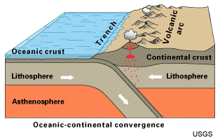
Convergent Boundaries – Subduction
When continental plates collide with oceanic plates, subduction occurs – the oceanic plate sinks beneath the continental plate;
Trenches are found beneath the ocean where the oceanic crust subducts, and volcanoes form along the coastline.
When two oceanic plates collide, usually the older, more dense plate subducts beneath the other, forming a volcanic island arc.

Slide 42
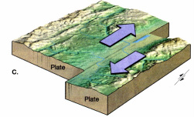
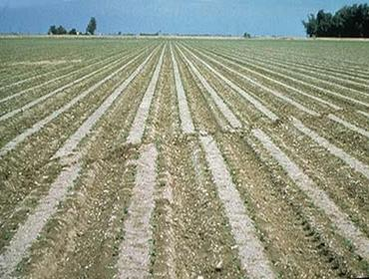
Transform Boundaries
Where two plates slide by each other instead of subducting or uplifting;
Results in frequent earthquakes.

Slide 43
6.6 Hot Spots
At many places on the crust there are a number of relatively static magma reservoirs.
In a few cases, these cause chains of volcanoes to form as a plate moves over these hot spots.

Slide 44
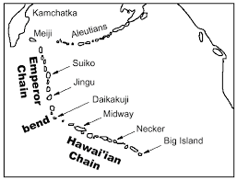
The Anaheim Volcanic Belt of British Columbia is a chain of cinder cones that cross central B. C. as a result of hot spot activity.
Some famous hot spots are the one lying beneath Yellowstone National Park and the one under the Island of Hawaii.

Slide 45
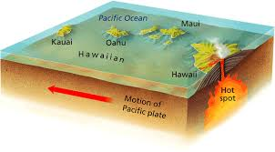
Each island of the Hawaiian chain of islands consists of one or more very large shield volcanoes that have formed over a hot spot.
As the Pacific Plate moves northwest over the hot spot, a chain of Islands have formed.

Slide 46
North of this Hawaiian chain is the Emperor Seamount Chain, a chain of older submerged volcanoes that is oriented in a more northerly direction.
This suggests that the Pacific Plate has not always followed its current direction.

Slide 47
https://www.youtube.com/watch?v=k0tnqPmwWvk

